Slide 1
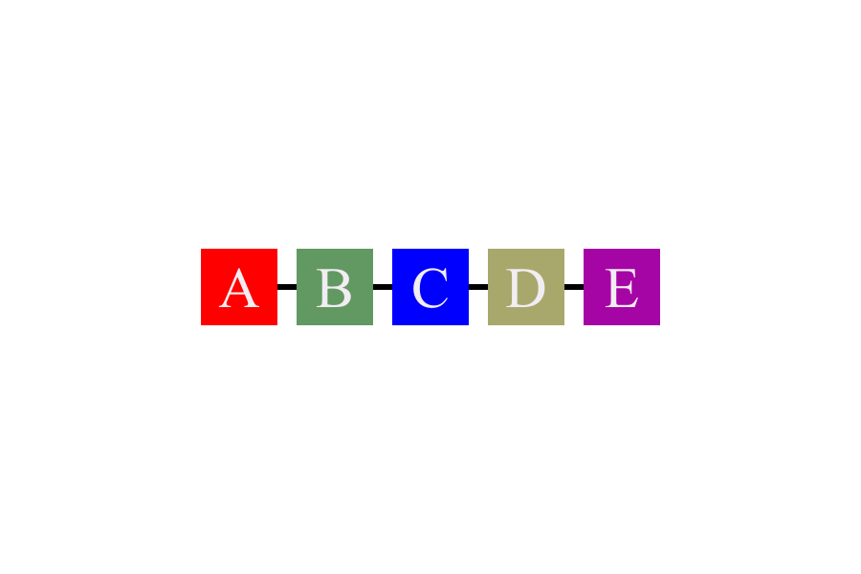
This is the demo for charts in pptx.

