Slide 1


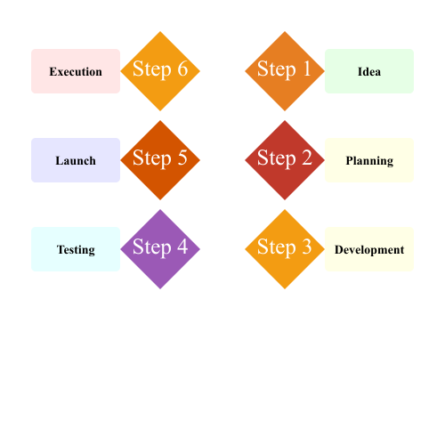
This is the demo for charts in pptx.

