Slide 1
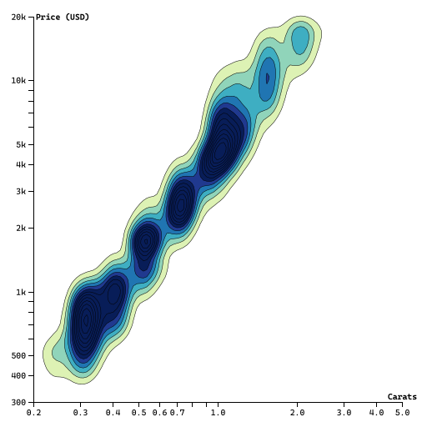
This is the demo for d3 image in pptx.

