Slide 1
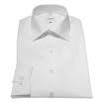
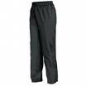
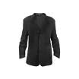
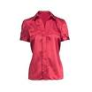
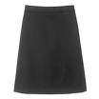
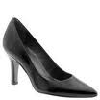
Product : Business Shirt
3 x 50 € = 150 €

Slide 2
Product : Trousers
3 x 80 € = 240 €

Slide 3
Product : Jacket
3 x 150 € = 450 €

Slide 4
Product : Blouse
3 x 60 € = 180 €

Slide 5
Product : Skirt
3 x 80 € = 240 €

Slide 6
Product : Ladies Shoes
2 x 120 € = 240 €

