Slide 1


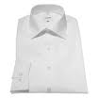

Made with <3 with APEXOfficePrint
(Dev Cred)
This is the basic example of using image tags.

