Slide 1




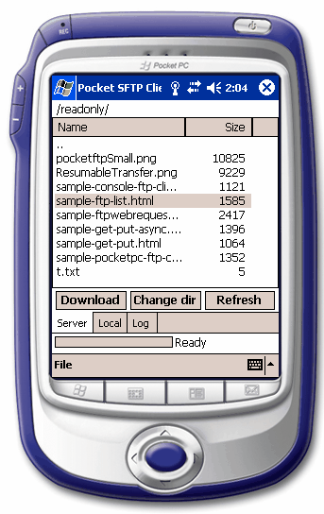

This template shows the possibility for the qrcode image replacing. This might come handy when for example you need to put the image that is not inline and has borders or styles.
The size, borders or shadings that are inserted into the qrcode will also be applied to the replaced image.
QRCode that usage the barcode tag.
QRCode that usages image tag and will get replaced from the given url.
The following image has base64 as source:
You can also use the images from ftp sources: ->

