Slide 1
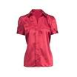
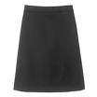
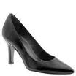
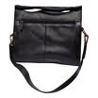
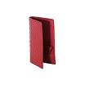
Product: Blouse
4 x 60 € = 240 €

Slide 2
Product: Skirt
4 x 80 € = 320 €

Slide 3
Product: Ladies Shoes
4 x 120 € = 480 €

Slide 4
Product: Bag
4 x 125 € = 500 €

Slide 5
Product: Wallet
2 x 50 € = 100 €

Slide 6
Product: Blouse
4 x 60 € = 240 €

Slide 7
Product: Skirt
3 x 80 € = 240 €

Slide 8
Product: Bag
2 x 125 € = 250 €

