Slide 1


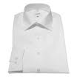
Product: Business Shirt
3 x 50 € = 150 €

Slide 2
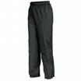
Product: Trousers
3 x 80 € = 240 €

Slide 3
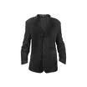
Product: Jacket
3 x 150 € = 450 €

Slide 4
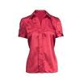
Product: Blouse
3 x 60 € = 180 €

Slide 5
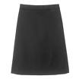
Product: Skirt
3 x 80 € = 240 €

Slide 6
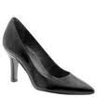
Product: Ladies Shoes
2 x 120 € = 240 €

Slide 7
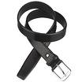
Product: Belt
2 x 30 € = 60 €

Slide 8
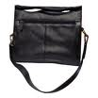
Product: Bag
4 x 125 € = 500 €

Slide 9
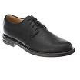
Product: Mens Shoes
2 x 110 € = 220 €

Slide 10
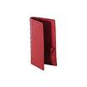
Product: Wallet
2 x 50 € = 100 €

